Slide 2
How create User Guide HTML with links to DOXYGEN
January 2018

Slide 3
Transform CPSS API documentation in Doxygen
User Guide HTML
User guide links to DOCSYGEN API
DOCSYGEN HTML/XML for CPSS API

Slide 4
User guide in HTML
User guide links to DOCSYGEN API
DOCSYGEN HTML/XML for CPSS API

Slide 5
Used addition commands for CPSS API documentation in Doxygen
Configuration
Input
User Guide HTML
CPSS release
CPSS repository
Output
User Guide HTML
DOXYGEN API HTML
DOXYGEN configuration

Slide 6
Generation DOCSYGEN HTML/XML for CPSS API
source code of the CPSS release
User guide links to DOCSYGEN API
Filter for customer API
Clean UP code

Slide 7
Filtering for customer API
Creating customer folder for API files
Generation DOCSYGEN XML for temp CPSS API
Creating temp folder for customer API files
XML parsing and Filtering for customer API functions
Generation DOCSYGEN HTML/XML for customer CPSS API

Slide 10
DOCSYGEN HTML/XML files
source code of the CPSS release
User guide links to DOCSYGEN API

Slide 14
The main objective
Used documentation generator Doxygen, for writing CPSS API reference documentation. The documentation is written within code, and is thus relatively easy to keep up to date.
Generate documentation from source code
See: http://www.stack.nl/~dimitri/doxygen/
Downloads
See: http://www.stack.nl/~dimitri/doxygen/download.html
Documentation manual
See: http://www.stack.nl/~dimitri/doxygen/manual/index.html
Commands
See: http://www.stack.nl/~dimitri/doxygen/manual/commands.html

Slide 15
Update CPSS API for Doxygen
Change documentation commands in source code
Generate up to date User Guide
Update links in User Guide to CPSS API

Slide 16
Update current CPSS API documentation command to Doxygen command
(c), Copyright
copyright
File_XXX.h
file
typedef: enum
enum
typedef: struct
struct
Function
[]|fn
typedef: union
union

Slide 17
Update current CPSS API Function command to Doxygen
DESCRIPTION:
brief
APPLICABLE DEVICES:
warning APPLICABLE DEVICES:
NOT APPLICABLE DEVICES:
warning NOT APPLICABLE DEVICES:
IN
param[in]
OUT
param[out]
RETURNS:
Retval
COMMENTS:
note

Slide 18
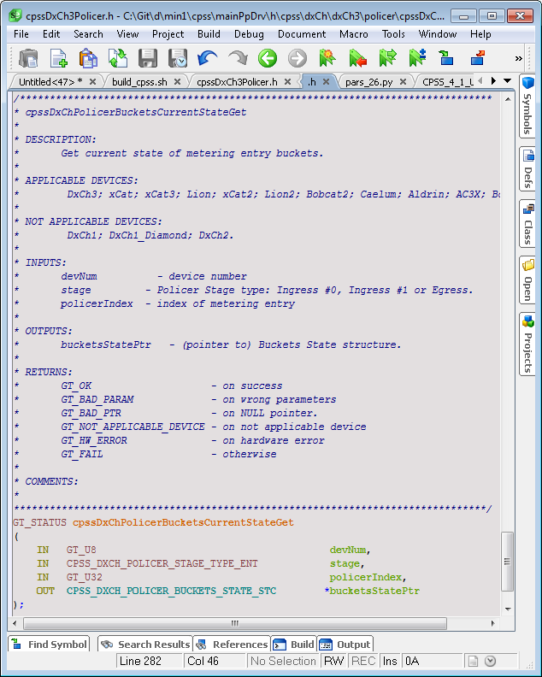
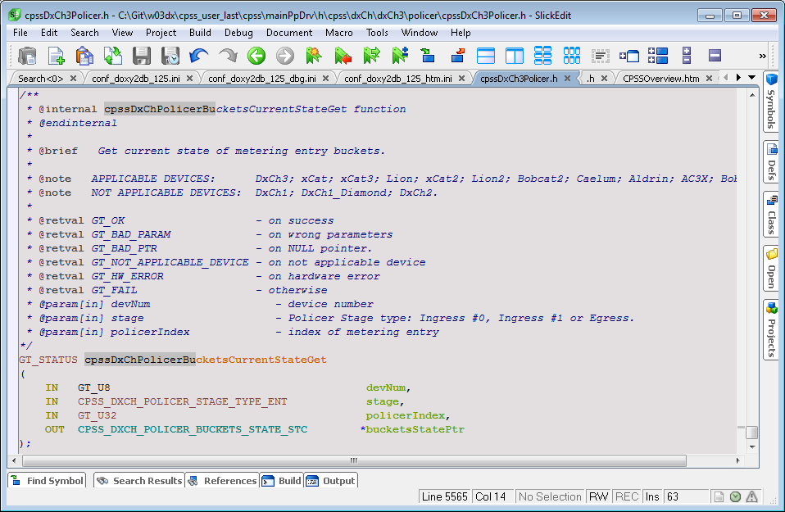
Change FUNCTION commands

Slide 19
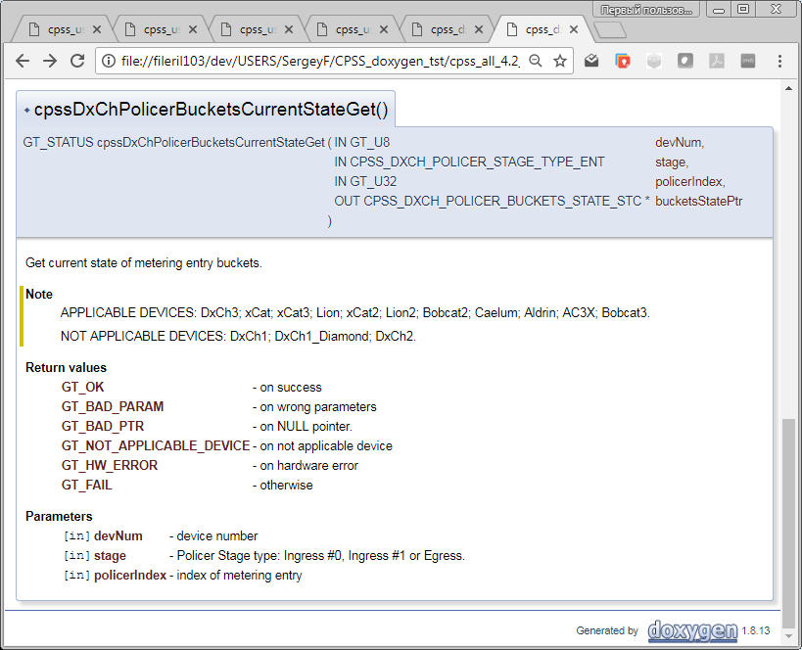
Doxygen

Slide 20
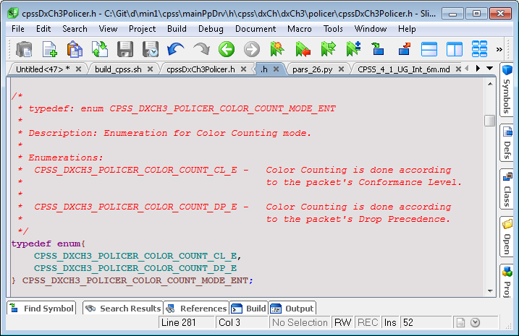
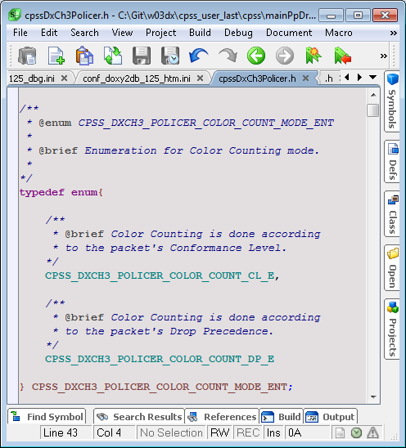
Change Enumeration commands

Slide 21
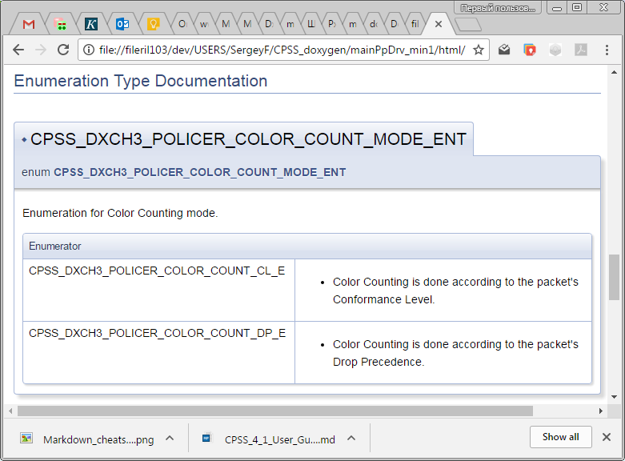
Doxygen

Slide 22
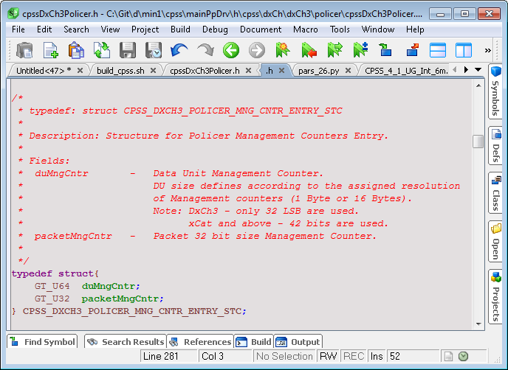
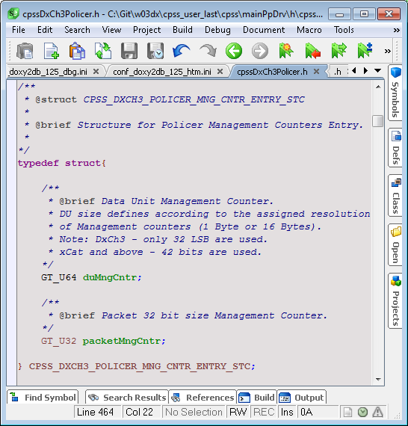
Change Structures commands

Slide 23
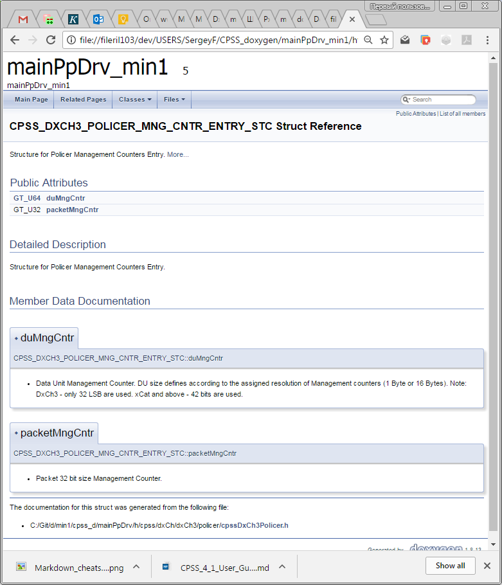
Doxygen

Slide 24
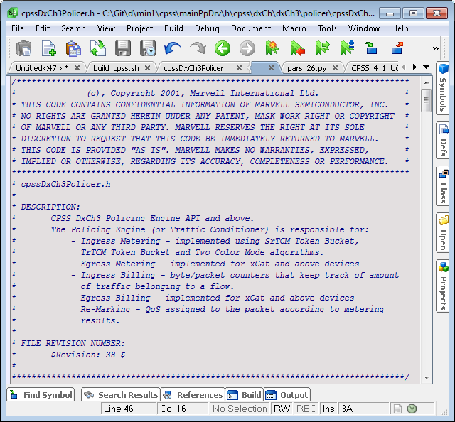
Copyright,File - before

Slide 25
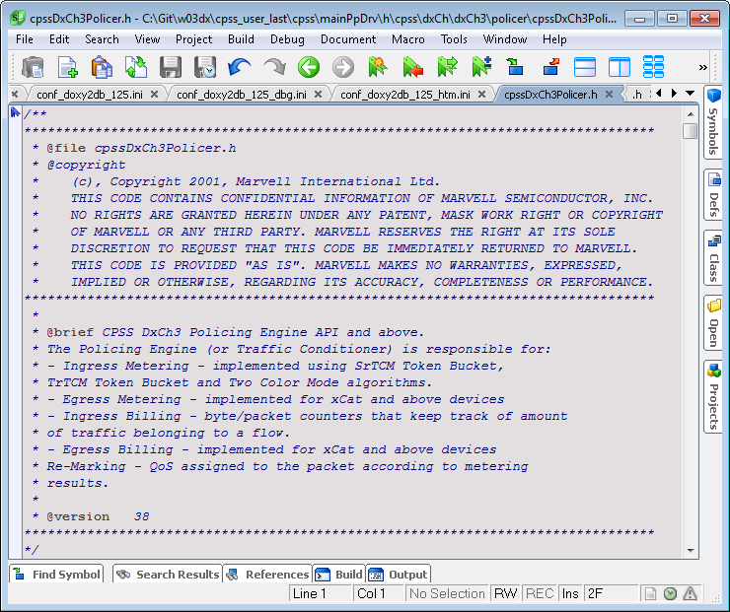
Copyright,File - after

Slide 26
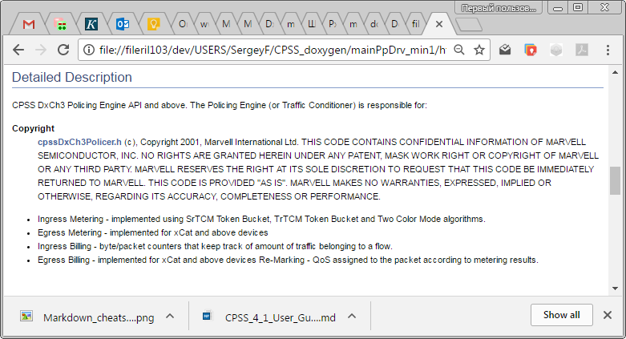
Doxygen html

Slide 27
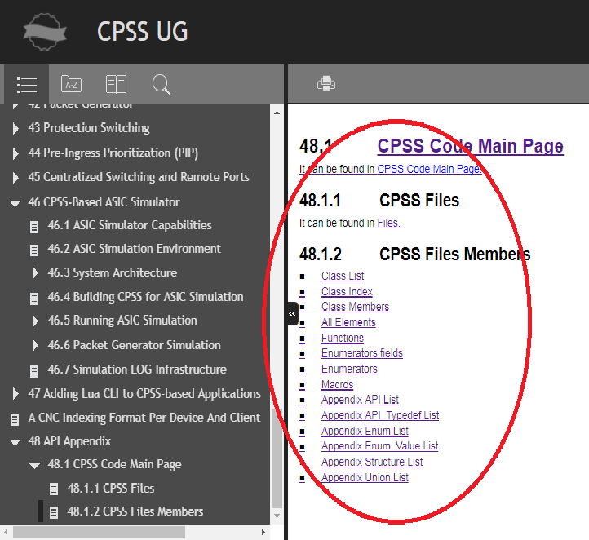
User Guide links to Doxigen

Slide 28
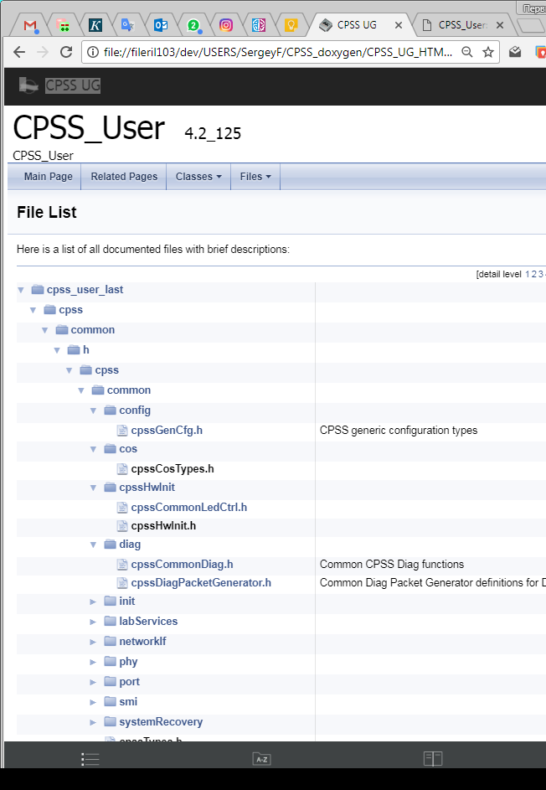
File List

Slide 29
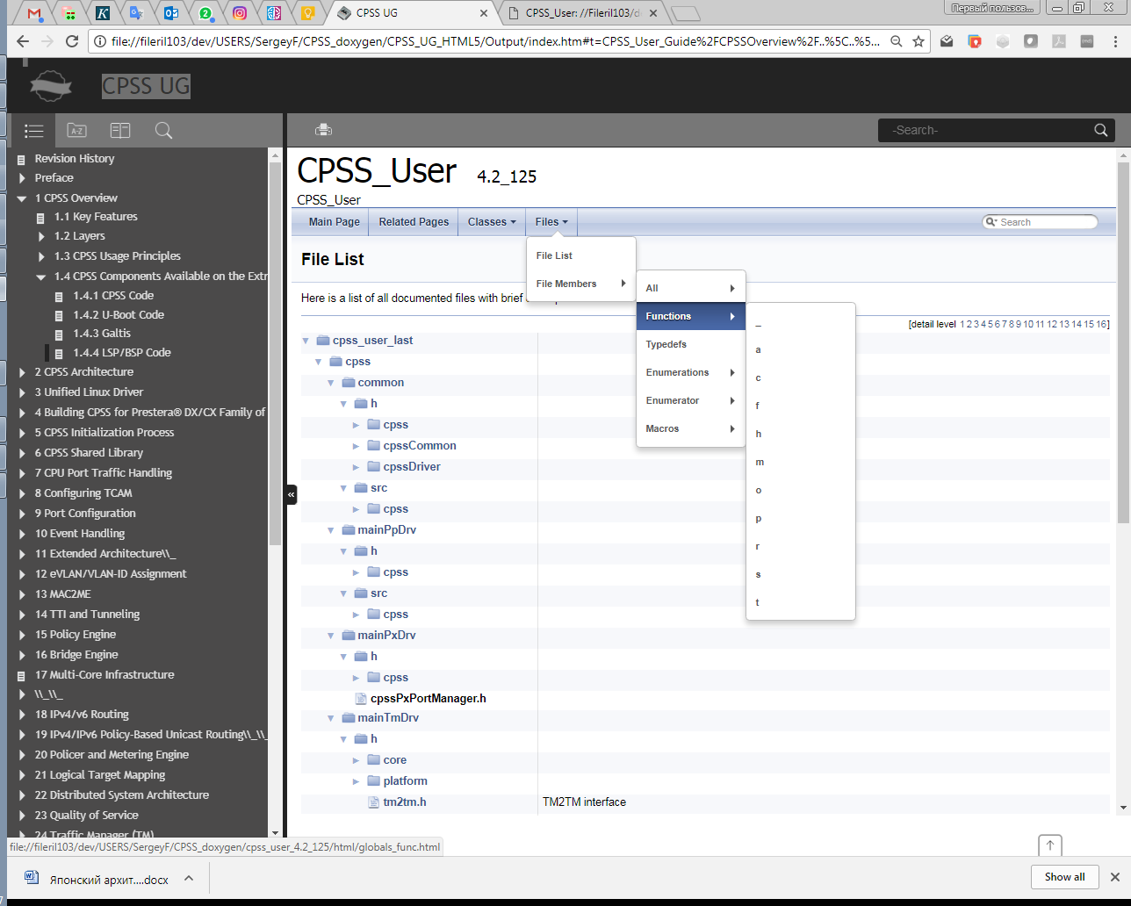
Functions

Slide 30
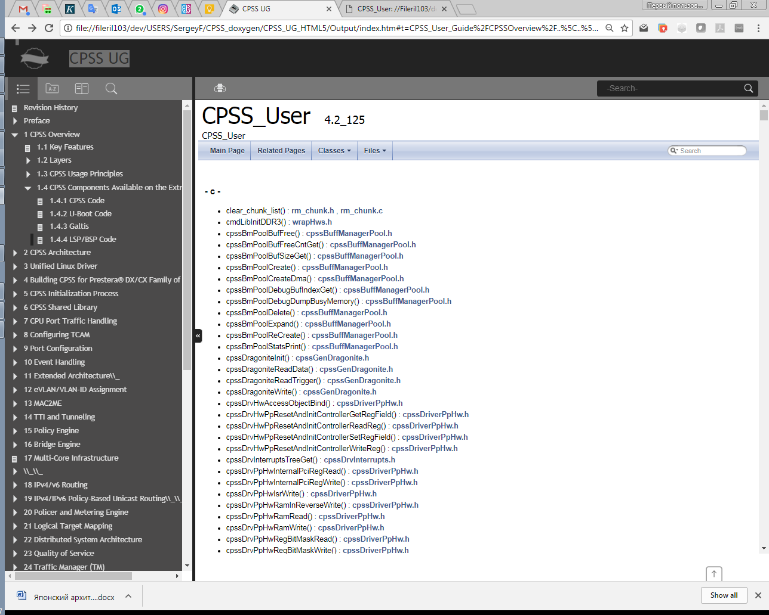
Functions list

Slide 31
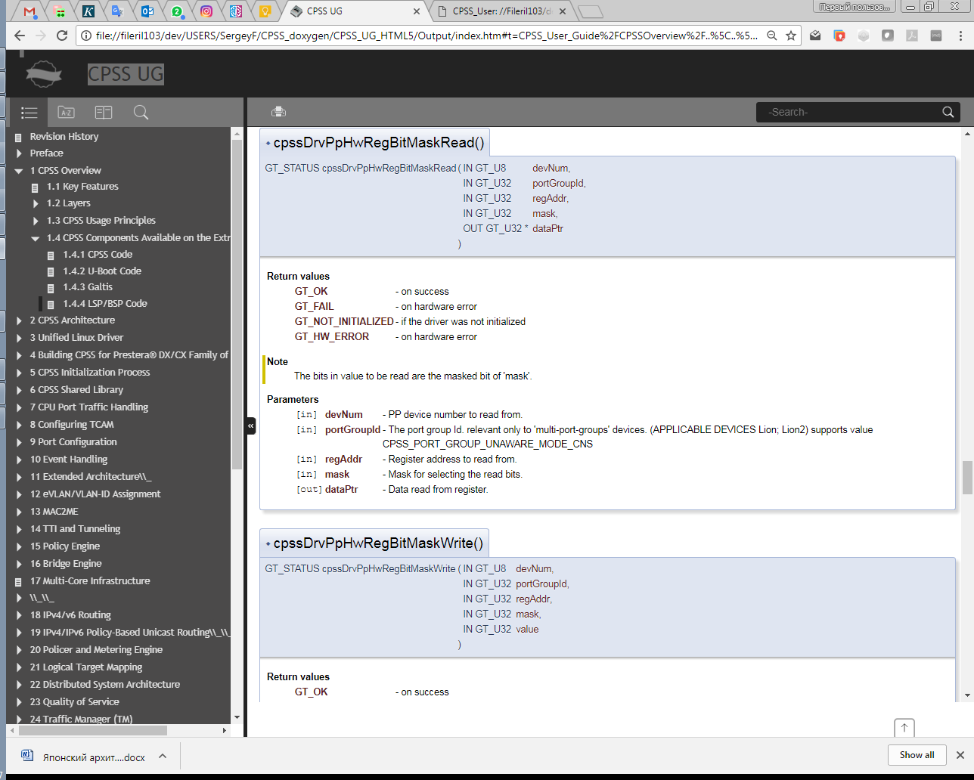
Function example

Slide 32
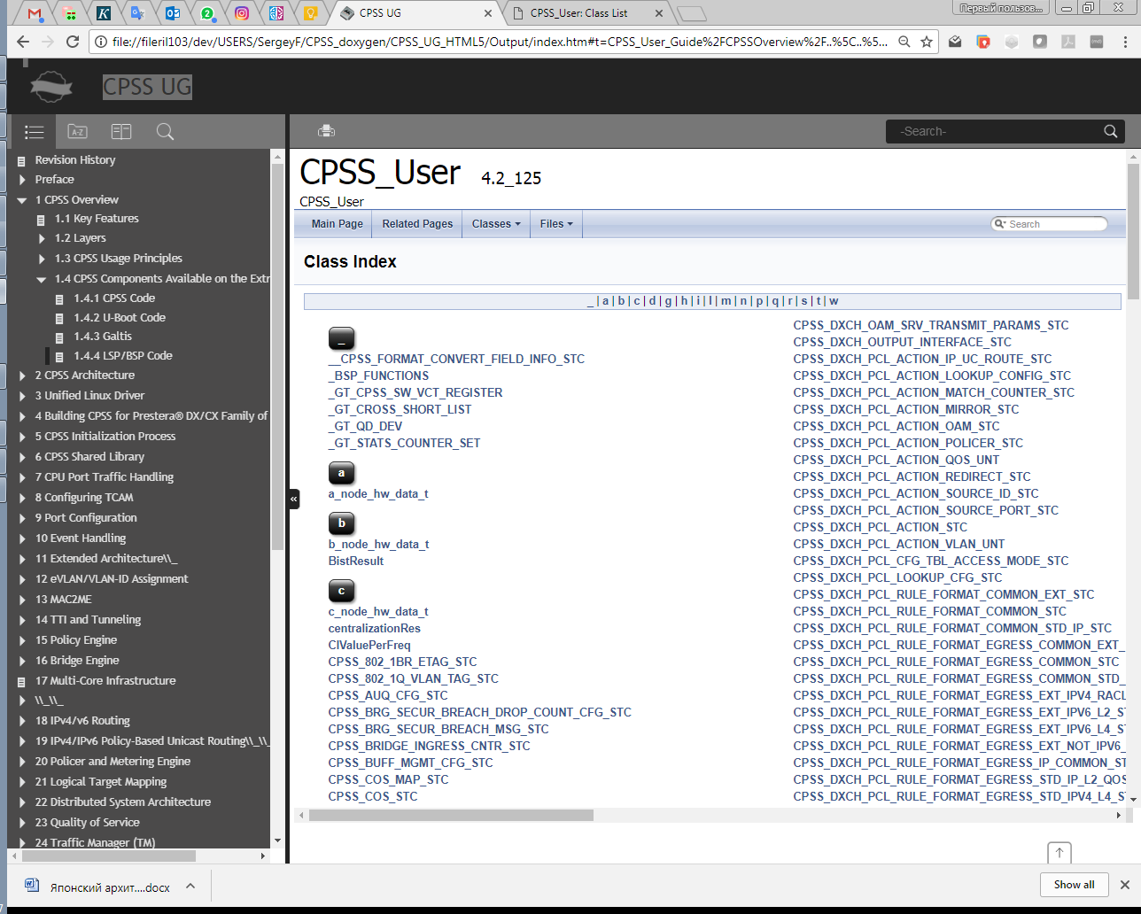
Class Index

Slide 33
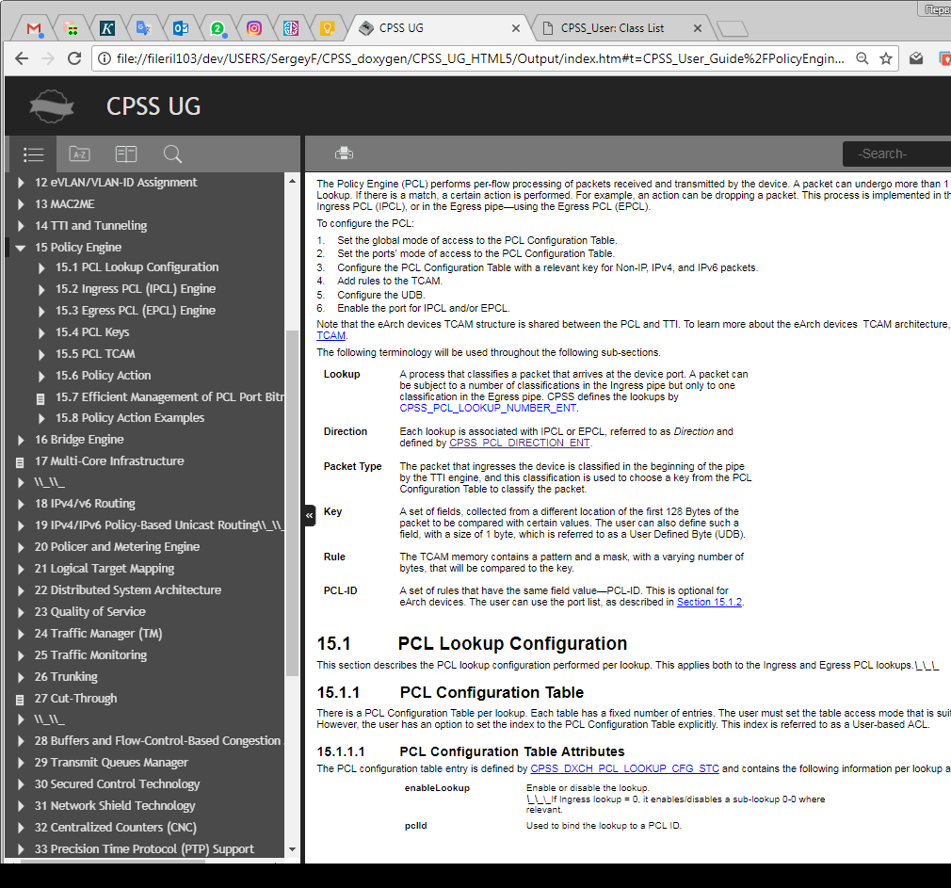
HTML User Guide with links to API

Slide 34
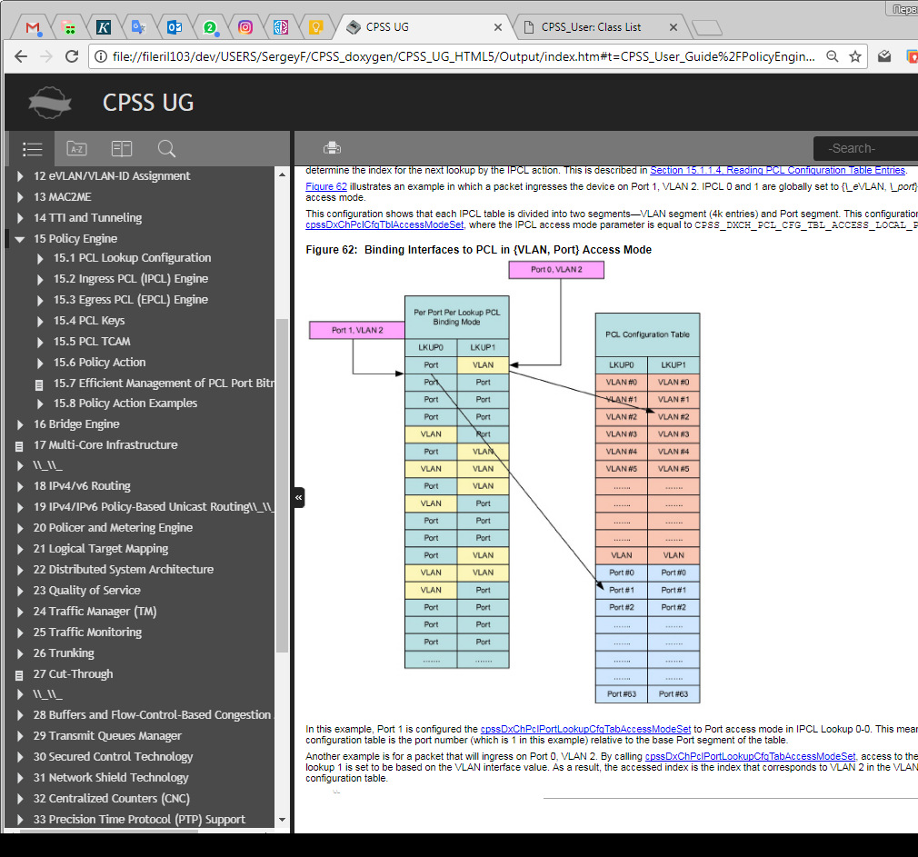
HTML User Guide with links figures

Slide 35
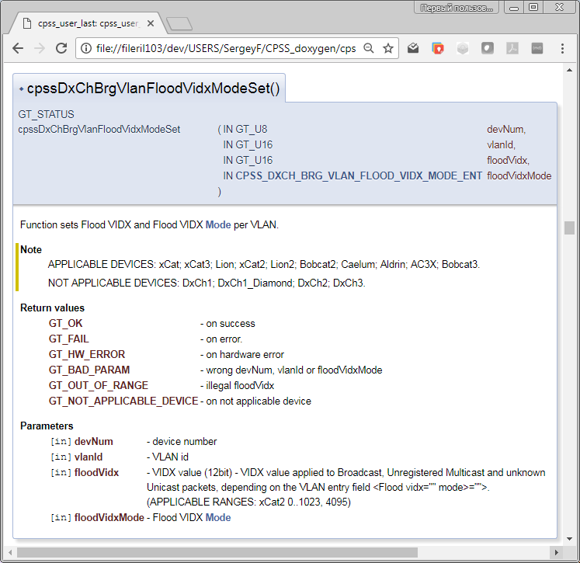
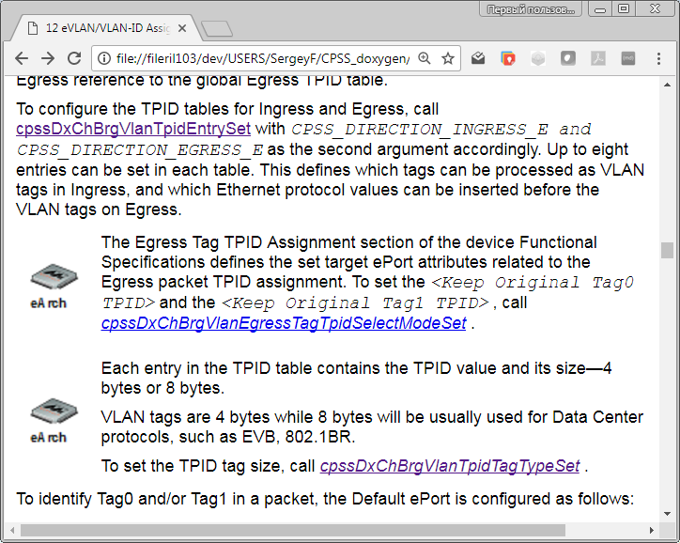

Slide 36
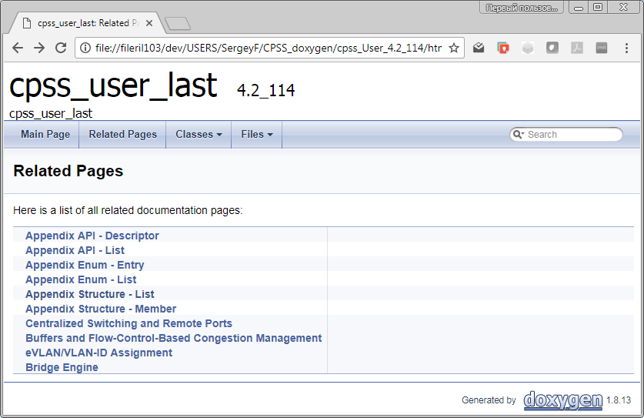
User Guide Related Pages

Slide 37
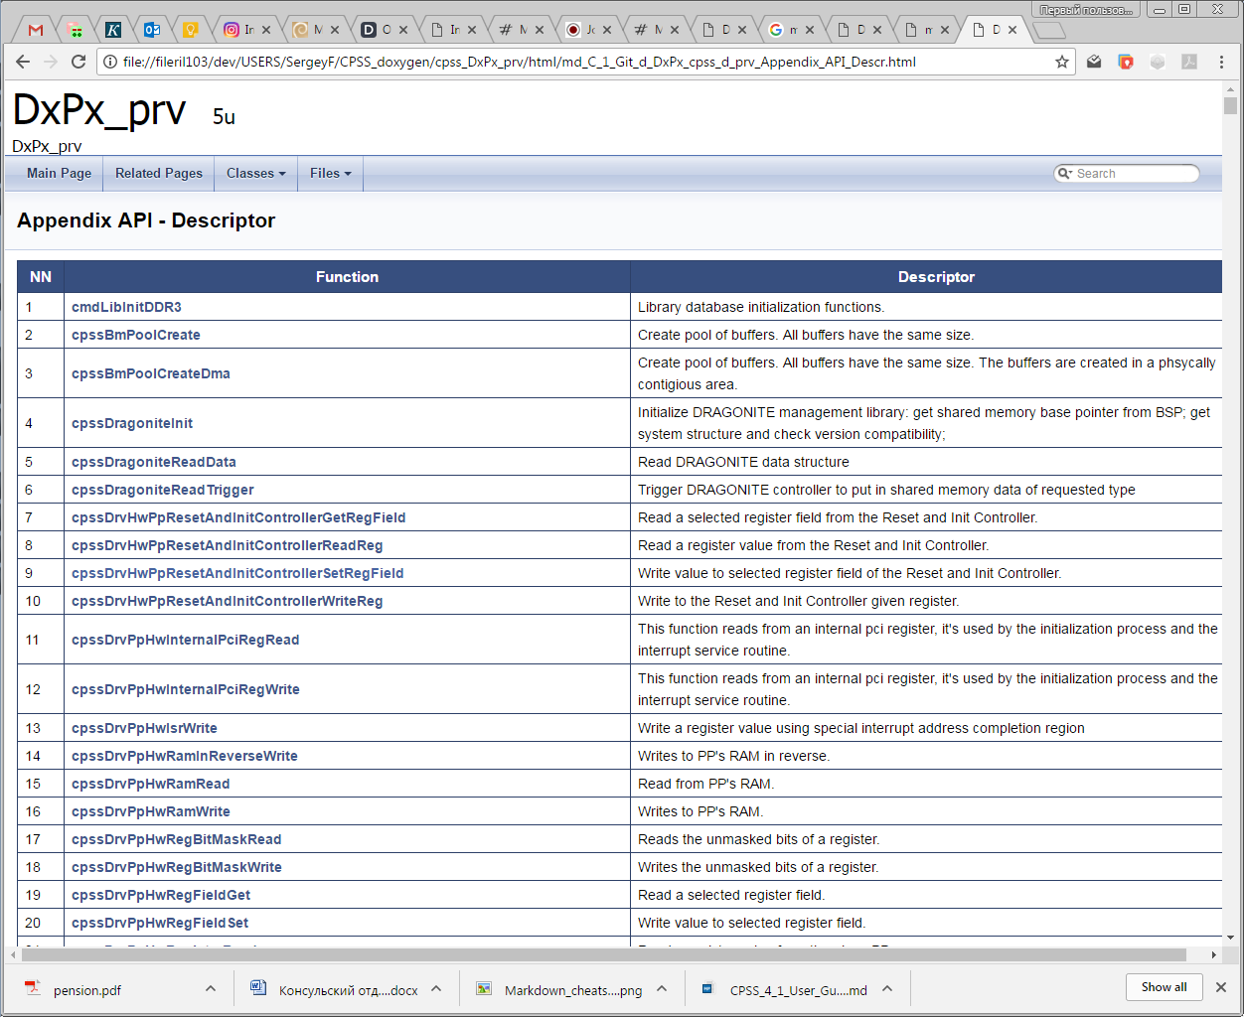
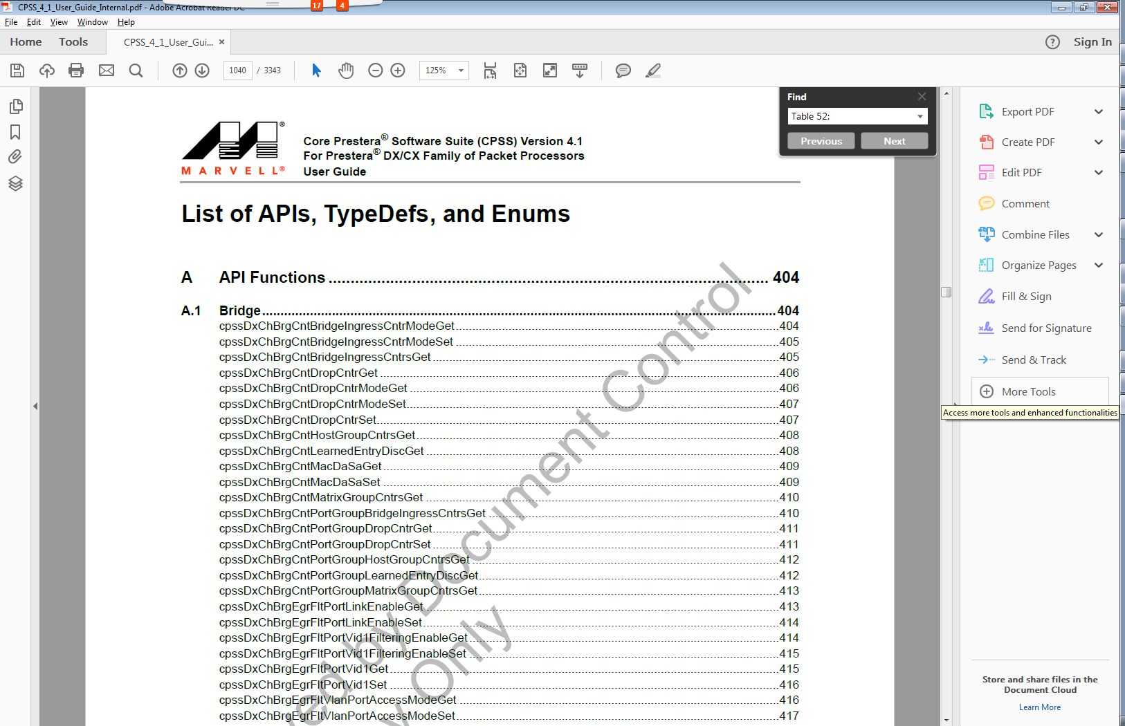
Up to date API Links

Slide 38
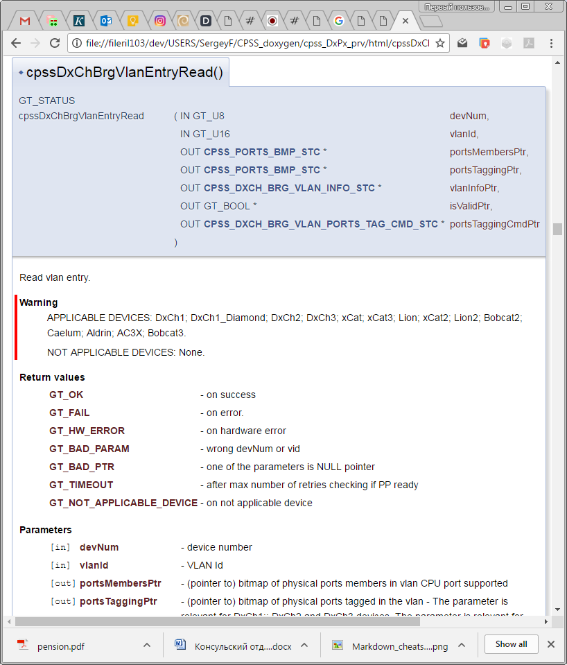
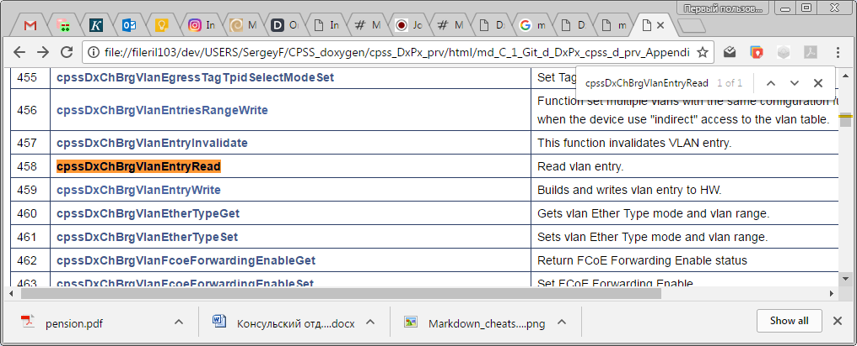
API Links

Slide 39
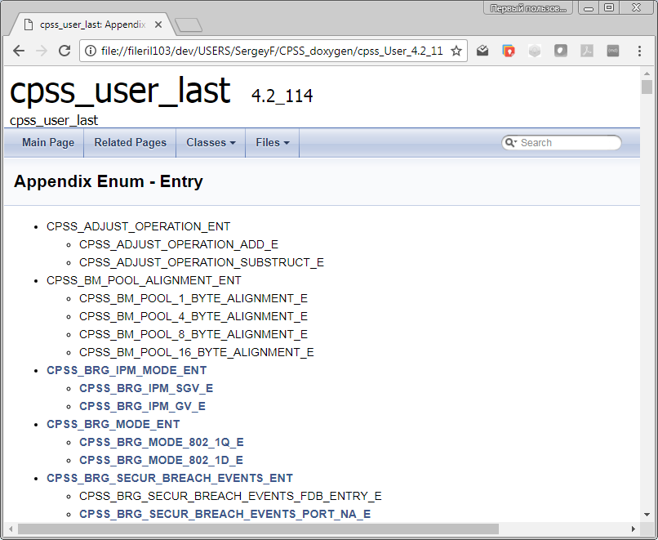
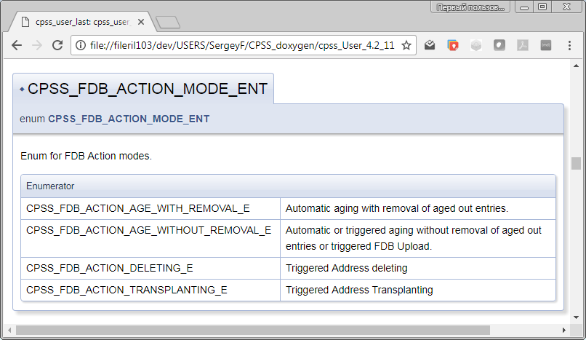
Appendix Enum - Entry

Slide 40
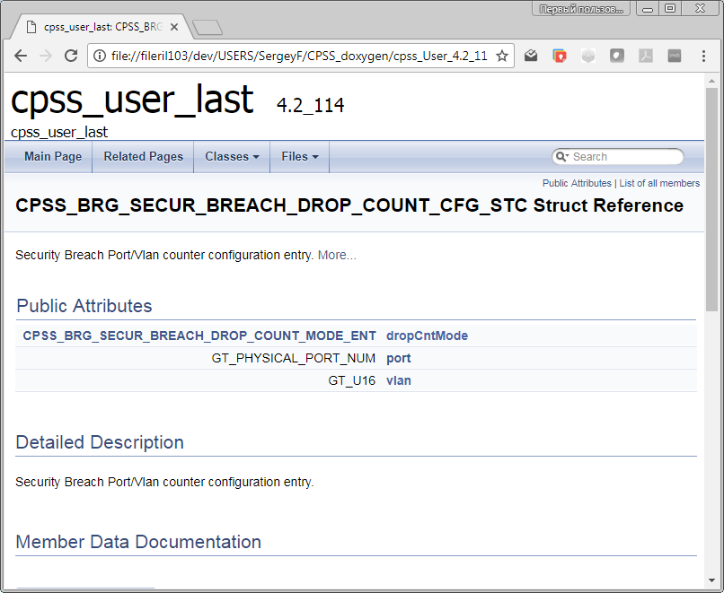
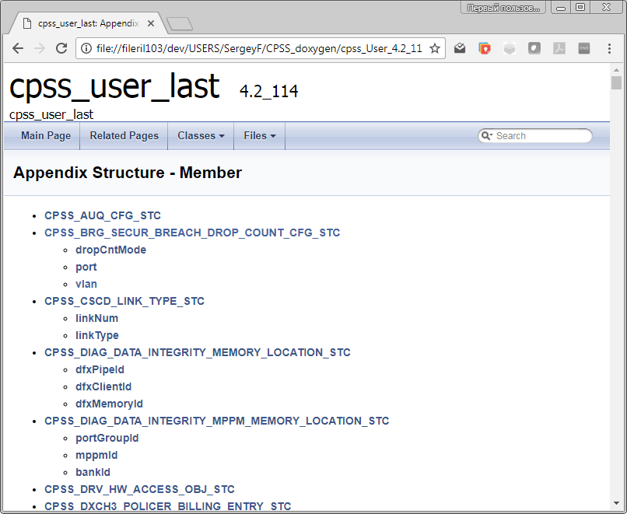
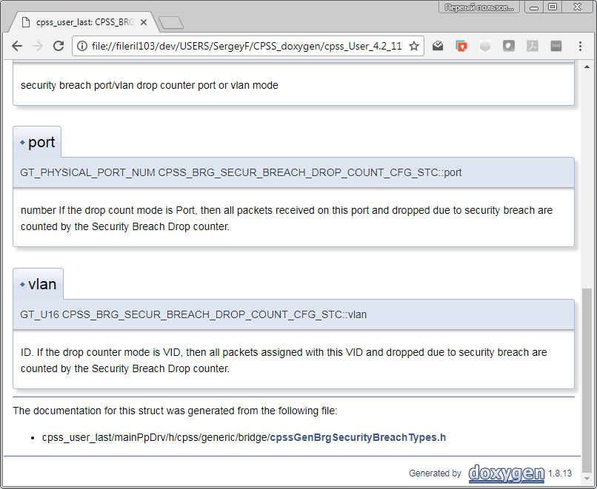
Appendix Structure - Member

Slide 41
Transform CPSS API to Doxygen documentation
Change commands in source code
Generate up to date User Guide
Transform User Guide to Markdown
Creating Main LUA Wrapper XML
Compare with old releases
Code clean up CS verification

Slide 42
Transform CPSS API documentation in Doxygen
User Guide text
Doxygen &
Source code

Slide 43
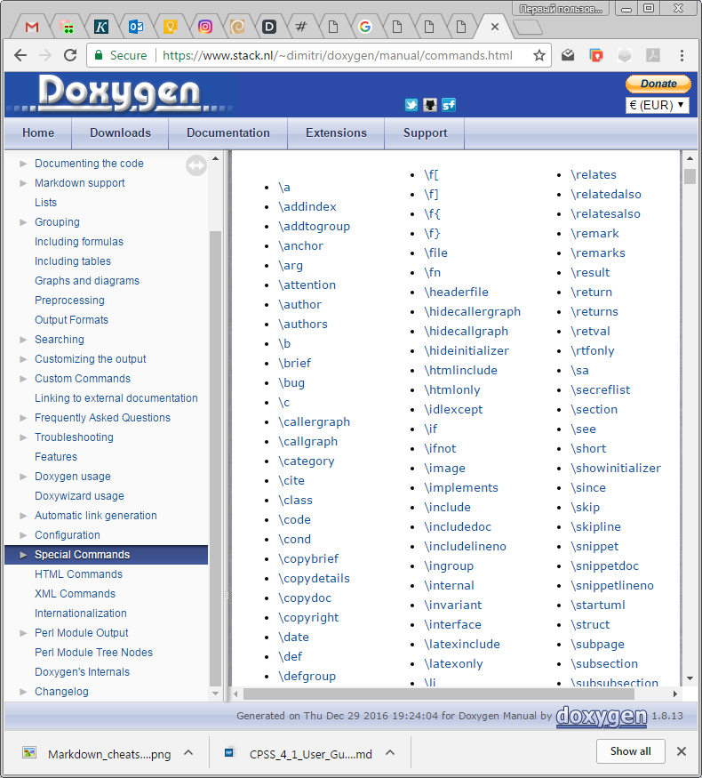
Used addition commands for CPSS API documentation in Doxygen
Commands
todo - paragraph describing what is to be done
see - references
example - <file-name>
bug - description

Slide 44
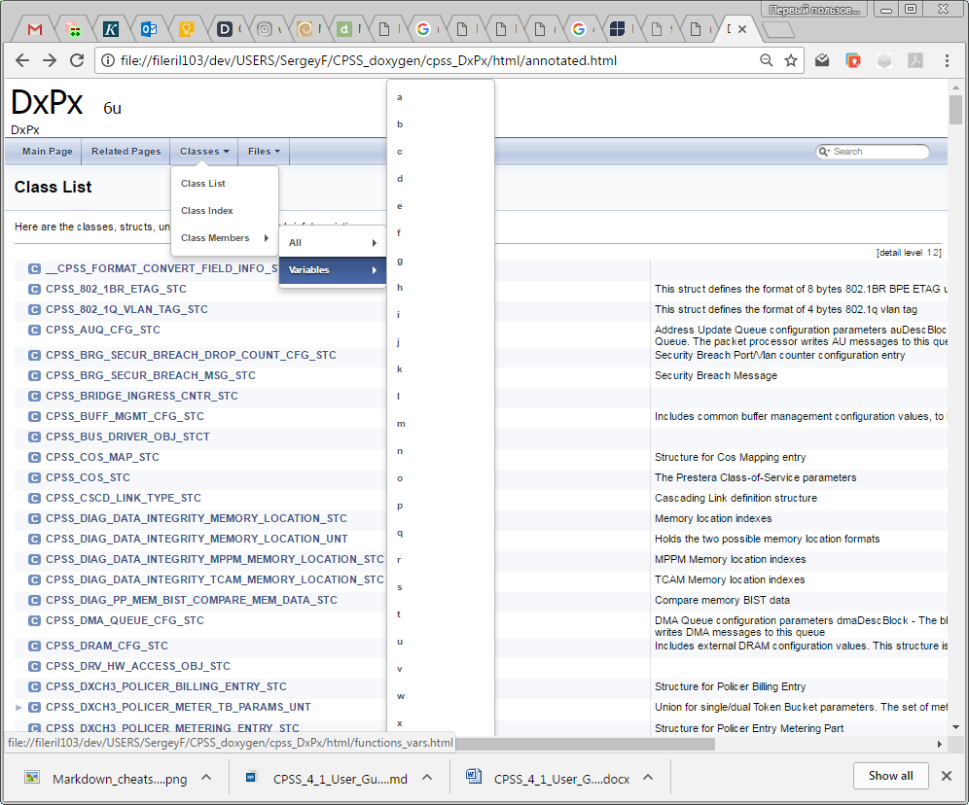
Using all opportunities of Doxigen

Slide 45
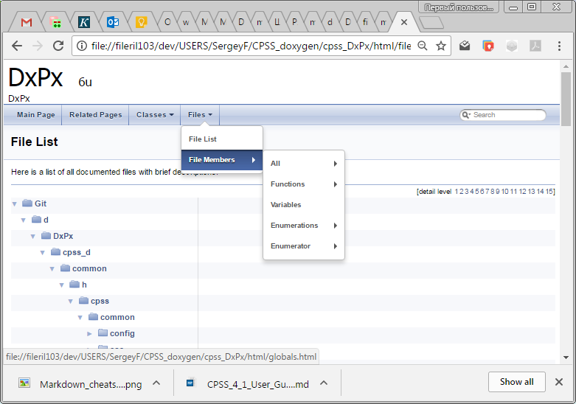
Using all opportunities of Doxigen

Slide 46
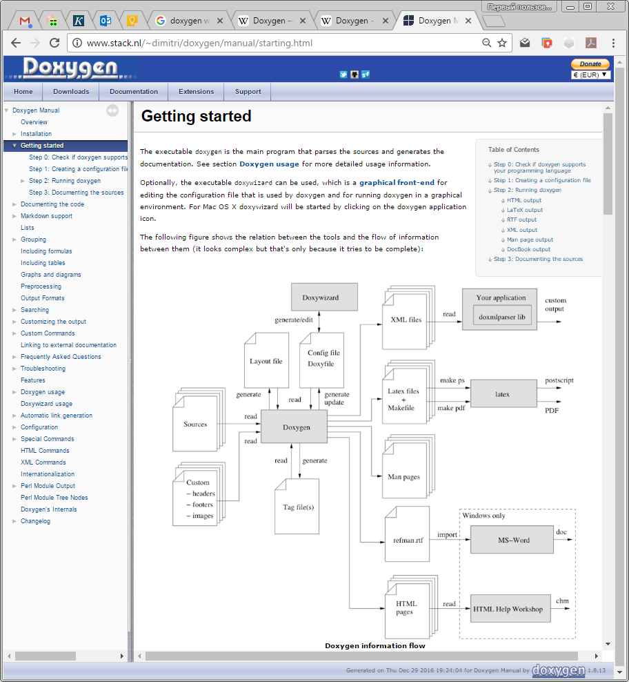
Using all opportunities of Doxigen

Slide 47
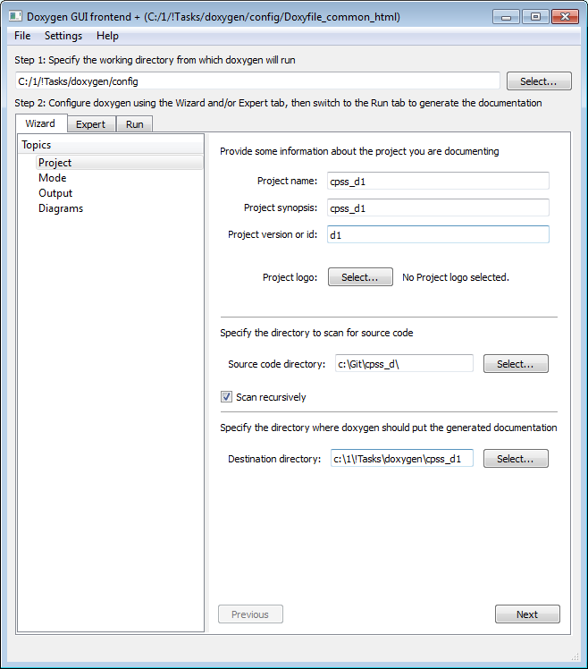
GUI DoxyWizard

Slide 48
Thank You!

